Slide 1
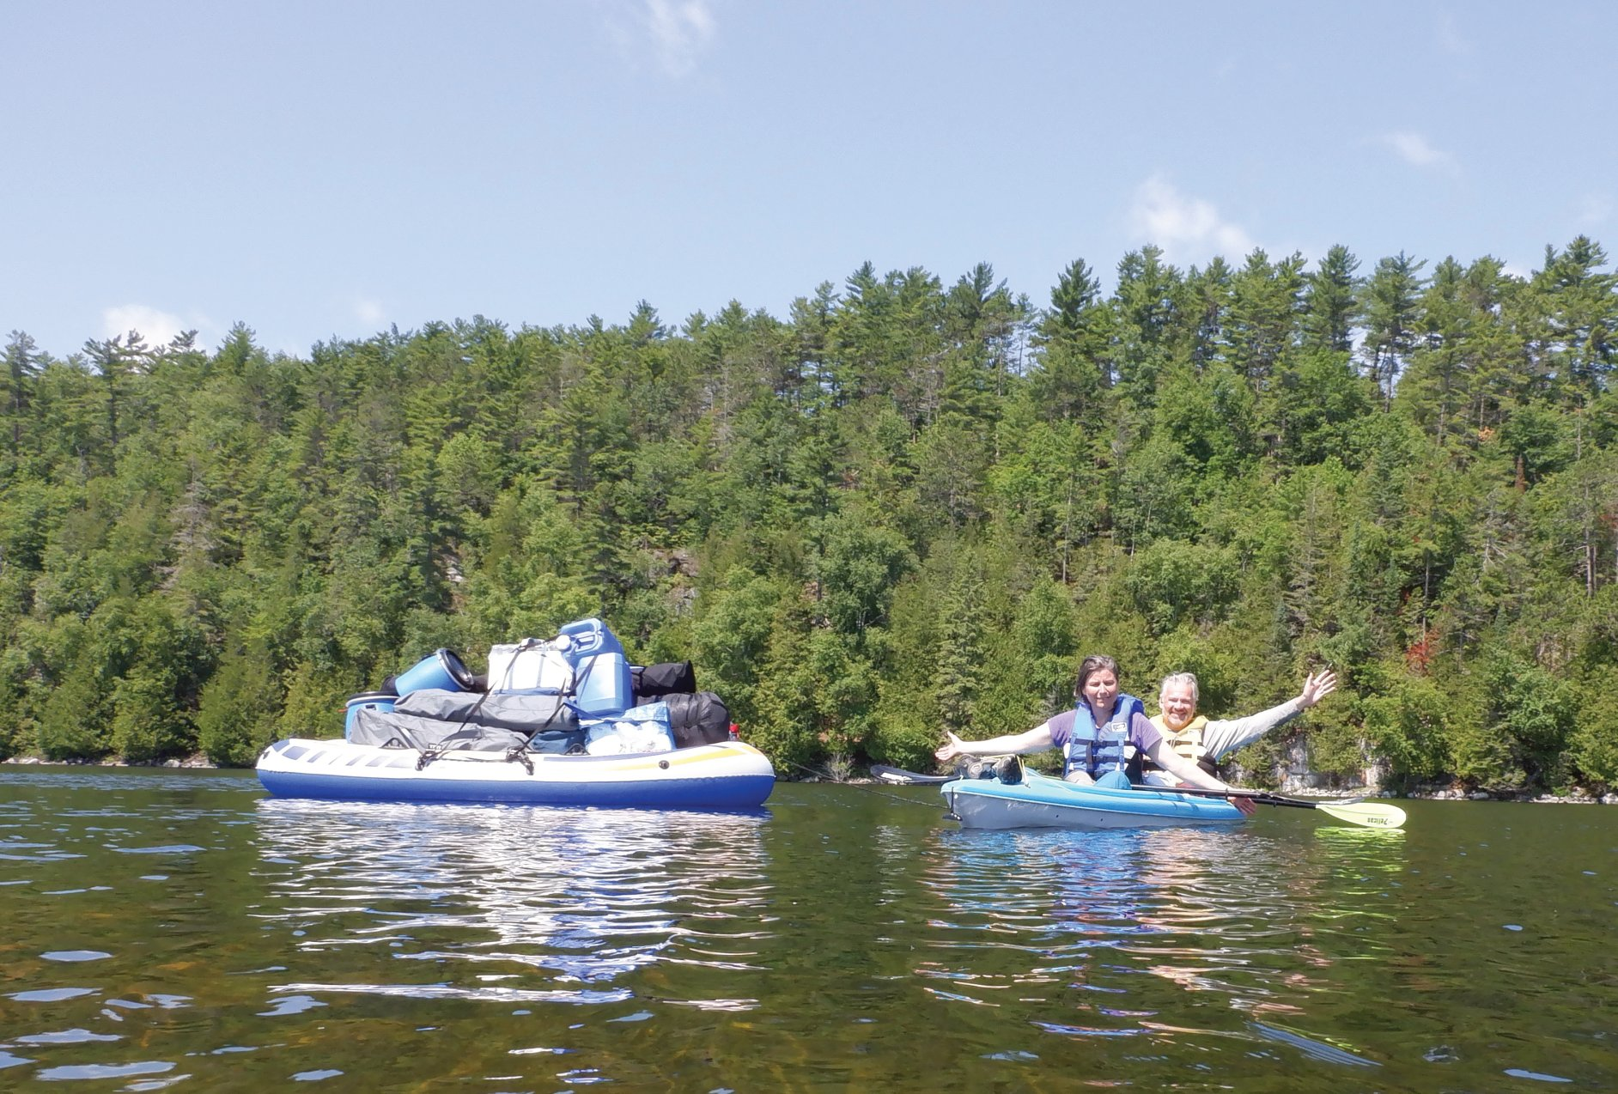


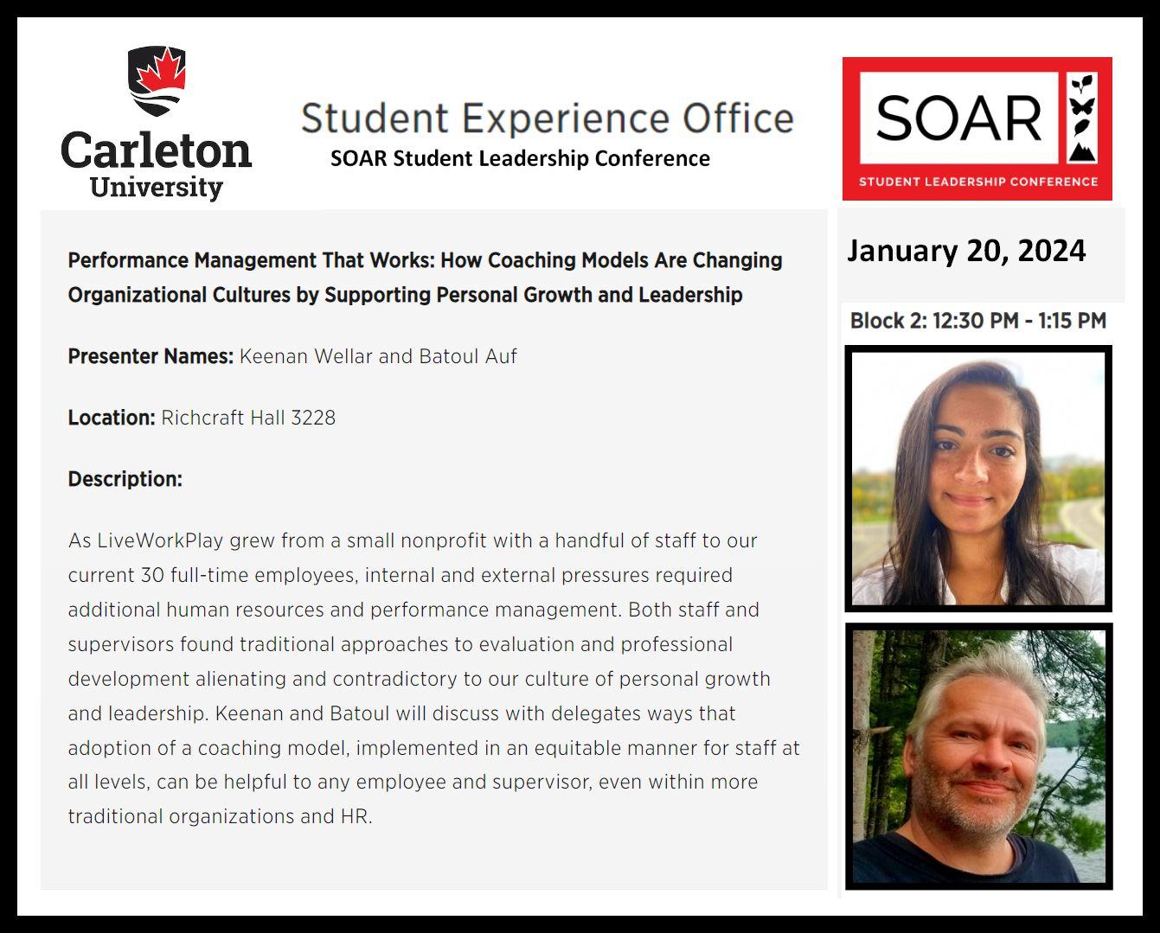
start

Slide 2
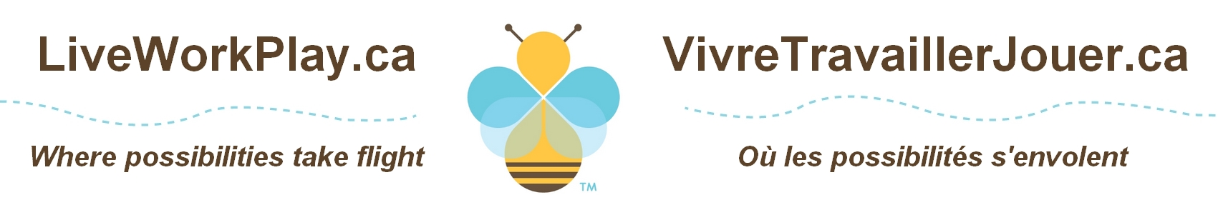
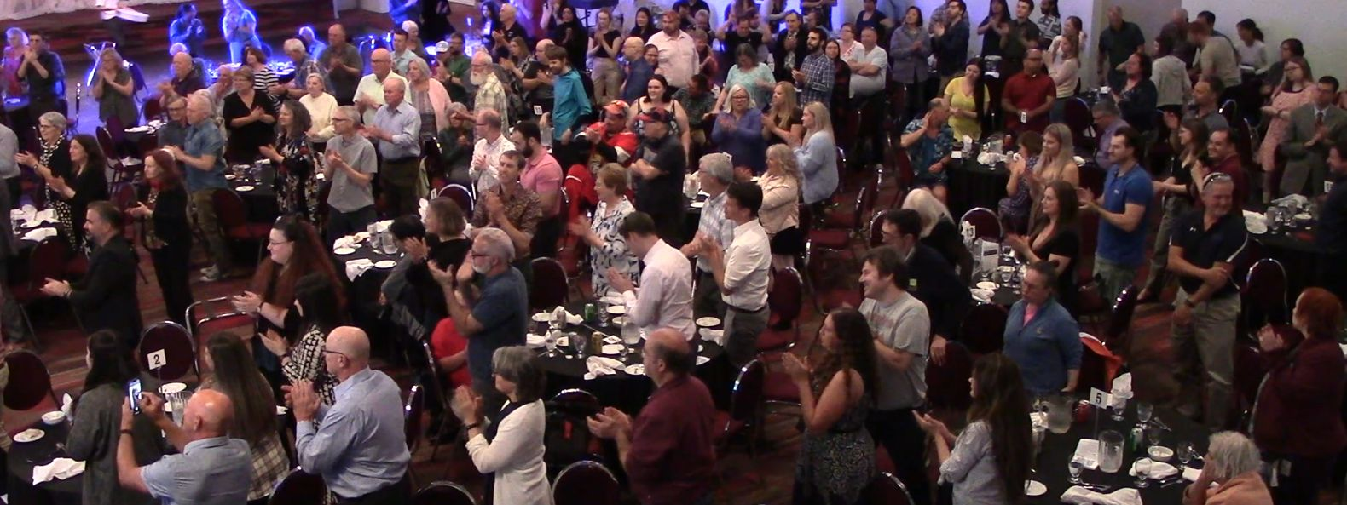
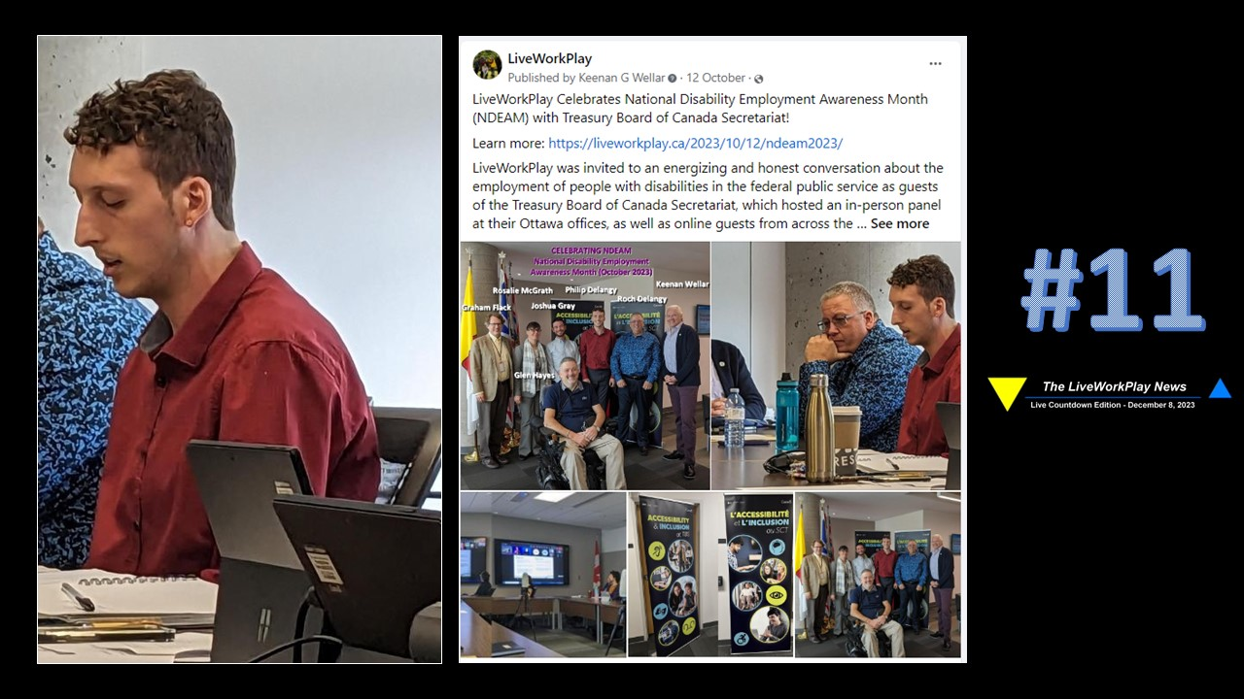
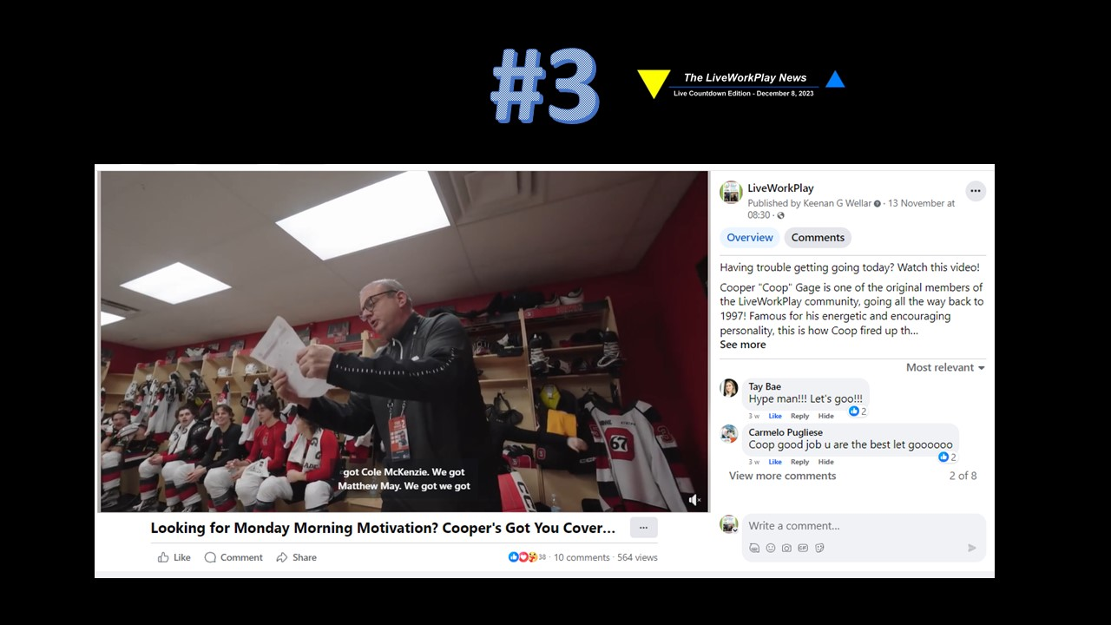
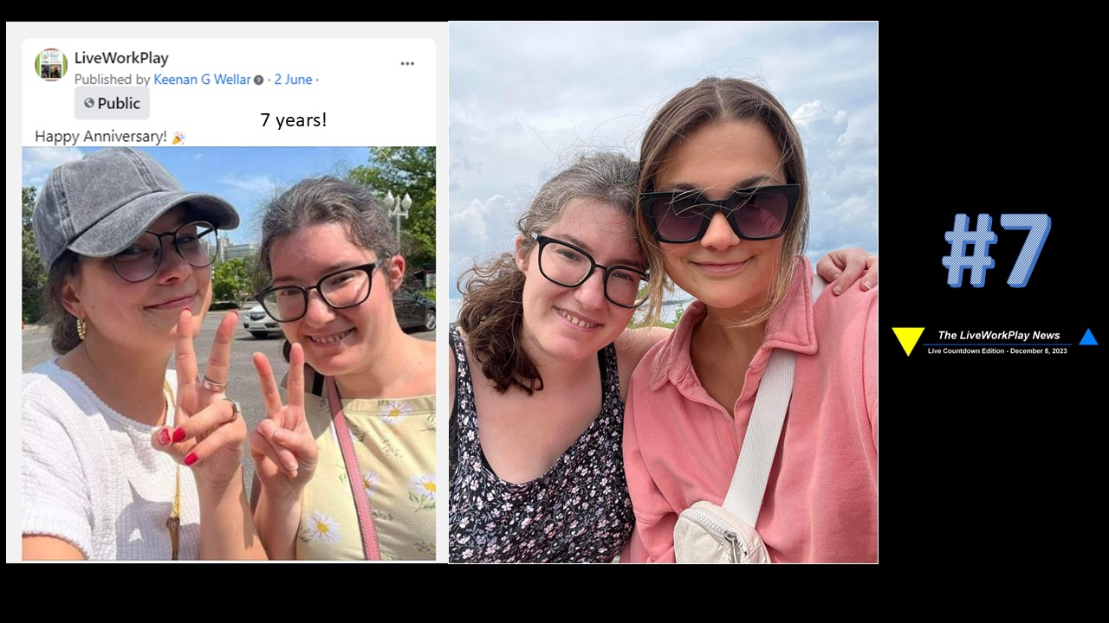
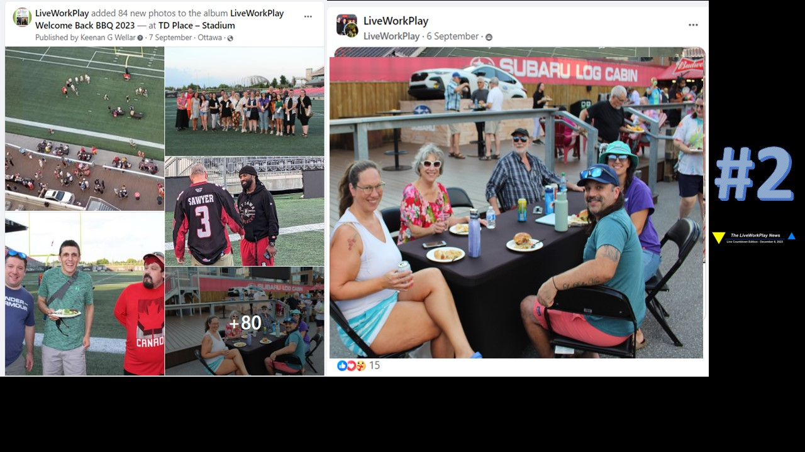
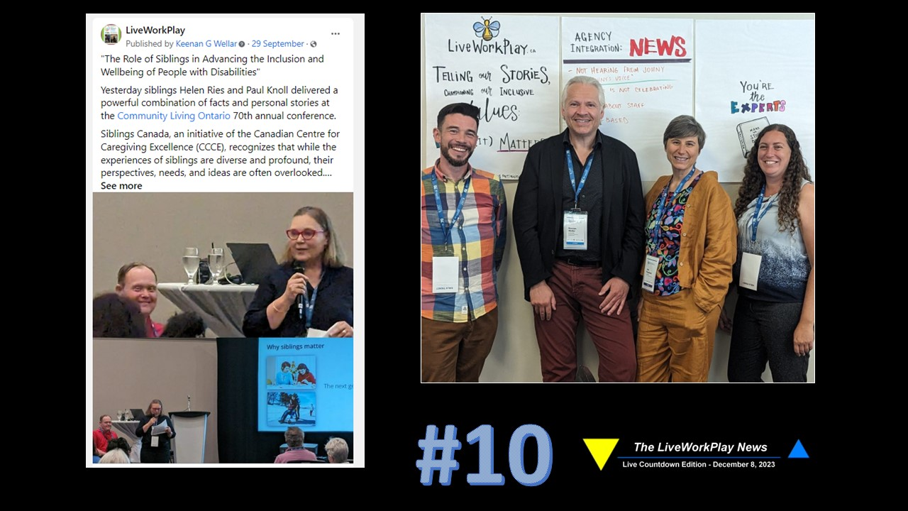
Us

Slide 3
Intro
LiveWorkPlay Guiding Statements
VISION: A COMMUNITY WHERE EVERYONE BELONGS
MISSION: HELPING OUR COMMUNITY WELCOME AND INCLUDE PEOPLE WITH INTELLECTUAL DISABILITIES, AUTISTIC PERSONS, AND INDIVIDUALS WITH A DUAL DIAGNOSIS TO LIVE, WORK, AND PLAY AS VALUED CITIZENS.
VALUES STATEMENTS
CORE: PEOPLE WITH INTELLECTUAL DISABILITIES ARE VALUABLE CONTRIBUTORS TO THE DIVERSITY OF OUR COMMUNITY AND TO THE HUMAN FAMILY.
LIVE: WITH RESPECT TO HOMES, HEALTH CARE, EDUCATION, PERSONAL DIGNITY, AND PERSONAL PRIVACY, PEOPLE WITH INTELLECTUAL DISABILITIES HAVE THE RIGHT TO THE REMOVAL OF BARRIERS PREVENTING THEM FROM EXPERIENCING THE COMMUNITY ON AN EQUAL BASIS WITH OTHER CITIZENS.
WORK: WITH RESPECT TO PAID WORK AT MINIMUM WAGE OR BETTER, SHORT-TERM UNPAID WORK, AND VOLUNTEER POSITIONS, PEOPLE WITH INTELLECTUAL DISABILITIES HAVE THE RIGHT TO THE REMOVAL OF BARRIERS PREVENTING THEM FROM EXPERIENCING THE COMMUNITY ON AN EQUAL BASIS WITH OTHER CITIZENS.
PLAY: WITH RESPECT TO CULTURAL AND SPIRITUAL LIFE, SPORTS ANDR ECREATION, POLITICAL LIFE, AND THE FULL RANGE OF HUMAN RELATIONSHIPS, PEOPLE WITH INTELLECTUAL DISABILITIES HAVE THE RIGHT TO THE REMOVAL OF BARRIERS PREVENTING THEM FROM EXPERIENCING THE COMMUNITY ON AN EQUAL BASIS WITH OTHER CITIZENS.
Adopted by Unanimous Vote of Members at LiveWorkPlay Annual General Meeting 2011. revised with Unanimous Vote of Members at LiveWorkPlay AGM 2019.
Along with our vision and values, our mission offers powerful guidance as to our perspective on exclusion and our strategy for inclusion. We have clearly situated the barriers (and solutions) to exclusion as residing with the community (not with the person), and our role is not only to help people with intellectual disabilities overcome these barriers, but also – and most importantly – to help the community understand their role in ending exclusion and appreciating people with intellectual disabilities as valuable members of the human family.
In 2018 we put a name to our approach: Just Enough Support. We also developed and elaborated seven principles to help explain it.
You can learn more about these in the Just Enough Support video series.

Slide 4
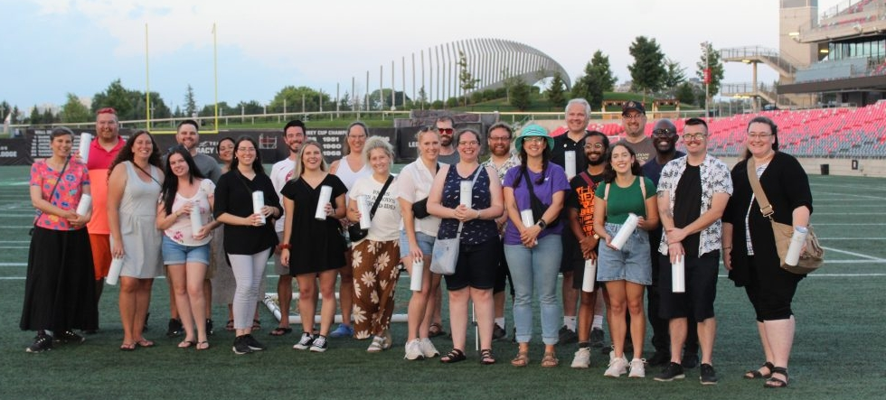
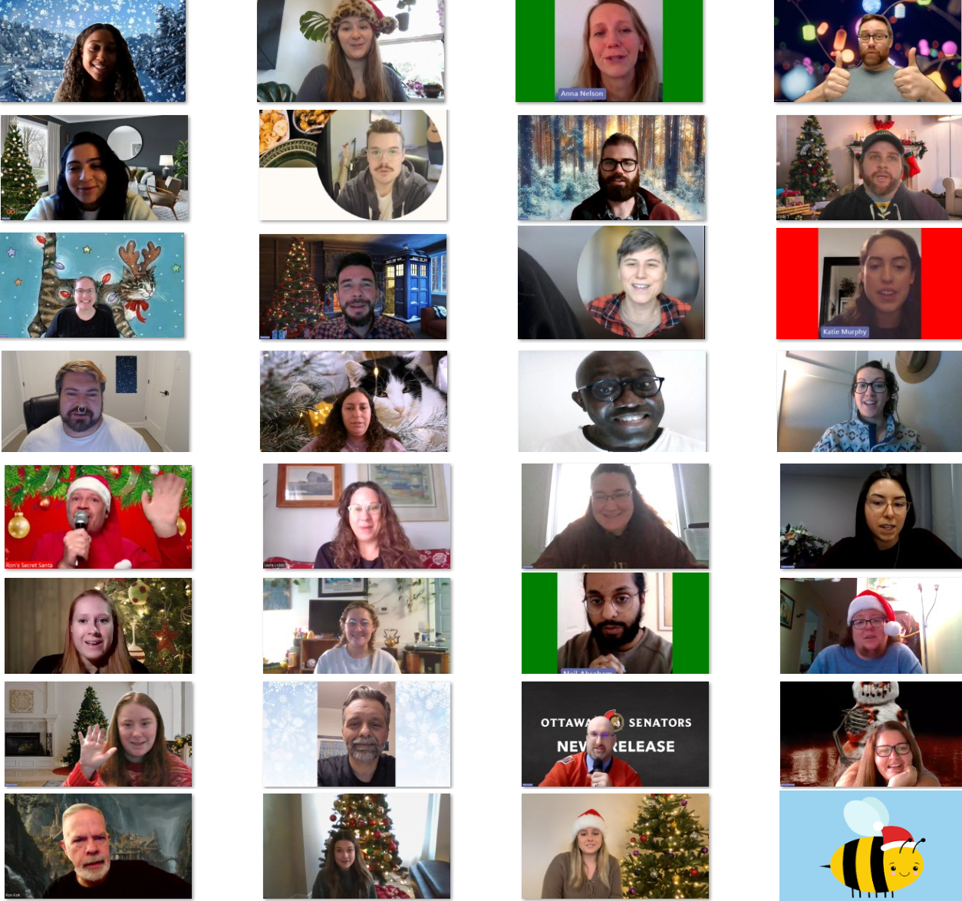
Our Team
Individual LiveWorkPlay staff members work independently but are also in constant interaction with their team.
They work in a values-based and clearly principled environment, but it takes tremendous diversity of
experience, skills, and gifts to properly serve our target population and our community.

Slide 5
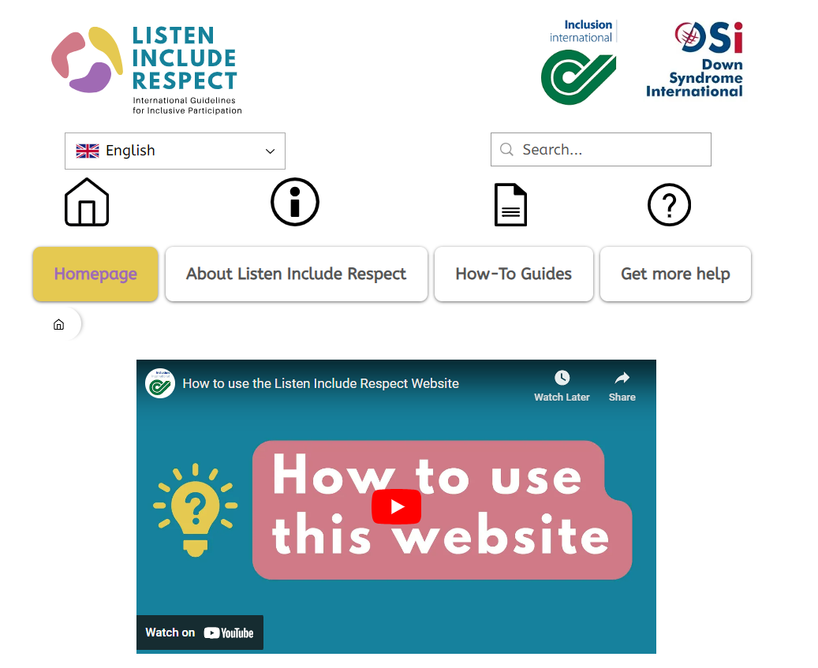
https://www.listenincluderespect.com/
These guidelines explain how organizations should include people with intellectual disabilities in different parts of their work.
The Listen Include Respect guidelines are important because right now, people with intellectual disabilities are not included in the work of organizations.
These guidelines can help organizations at different stages in their inclusion journey to take steps towards making their work more inclusive so that everyone can take part and share their valuable ideas.

Slide 6
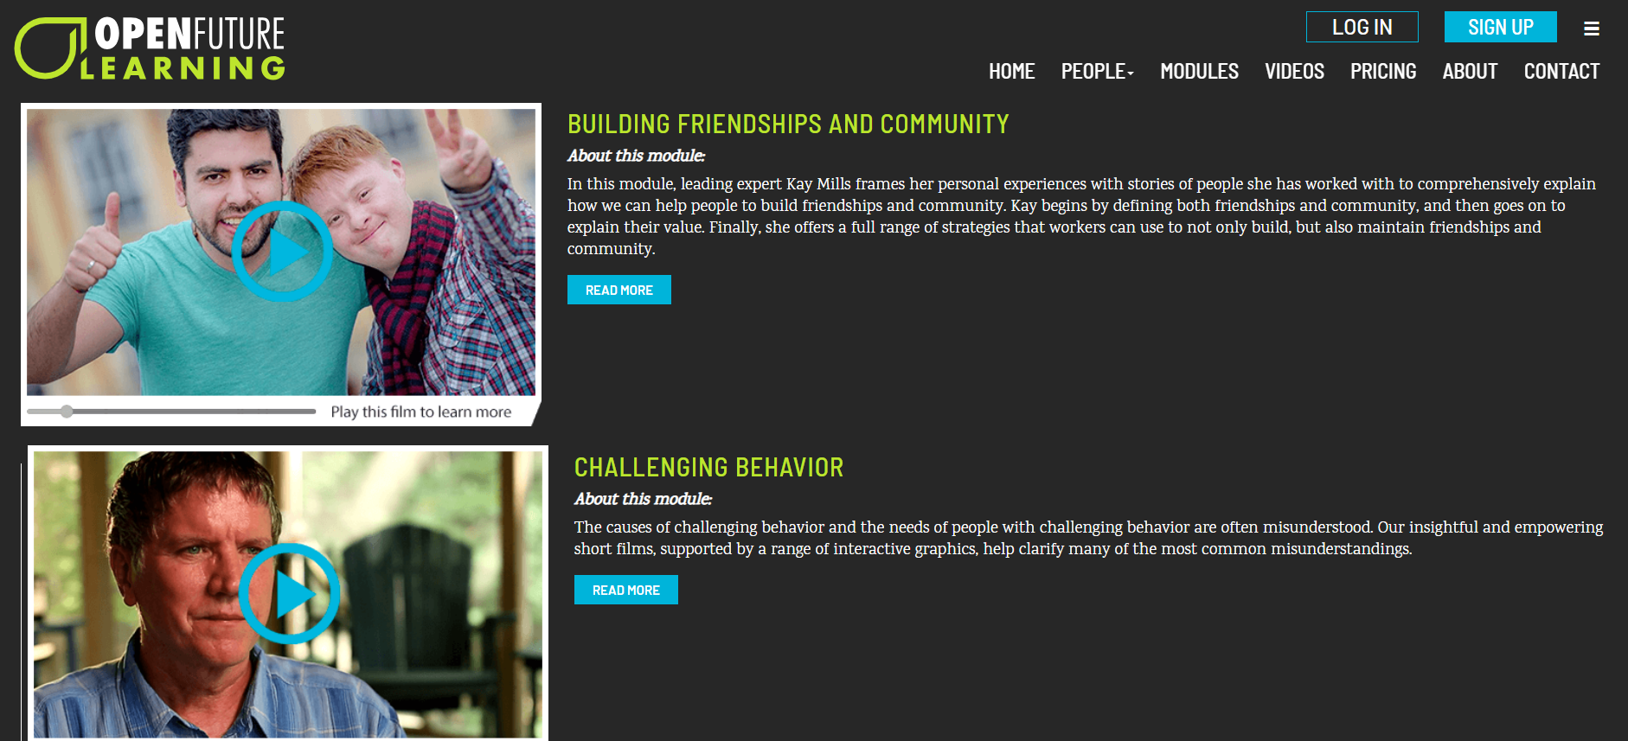
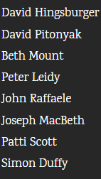
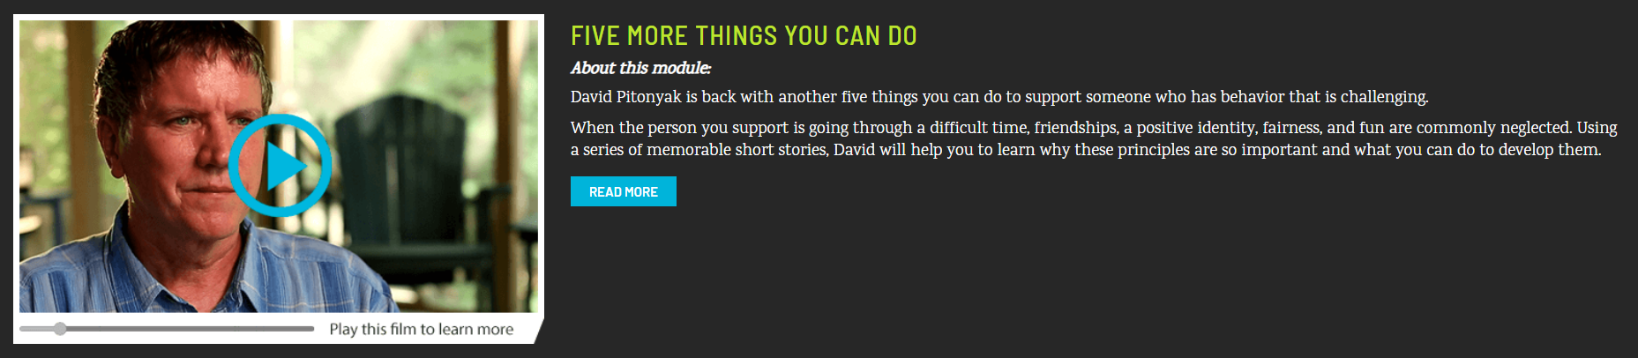
https://www.openfuturelearning.org/

Slide 7
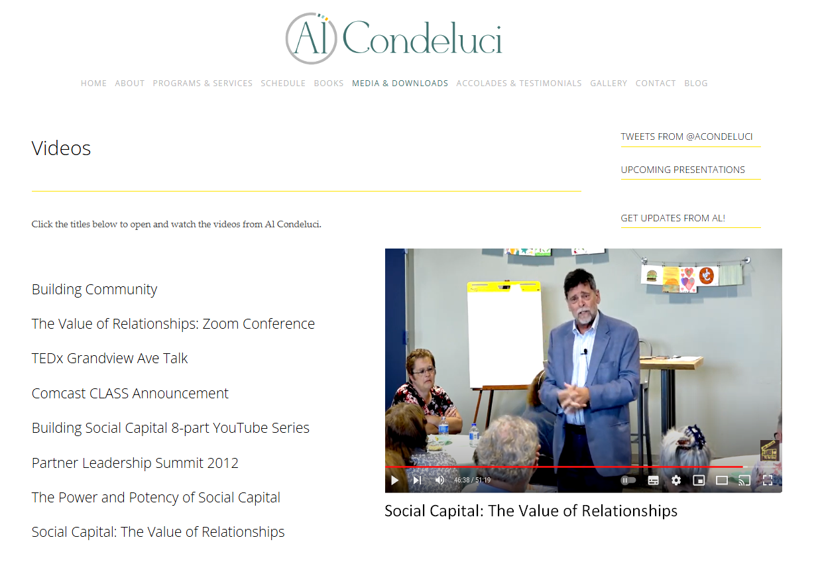
https://www.alcondeluci.com/

Slide 8
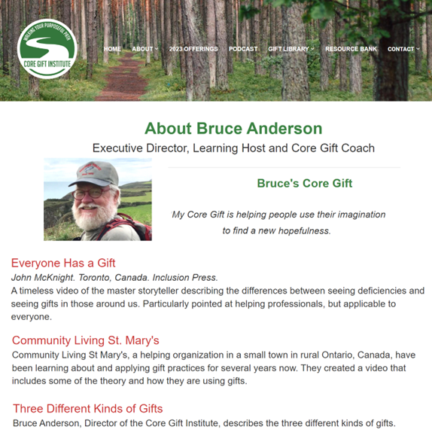
https://www.coregift.org/

Slide 9
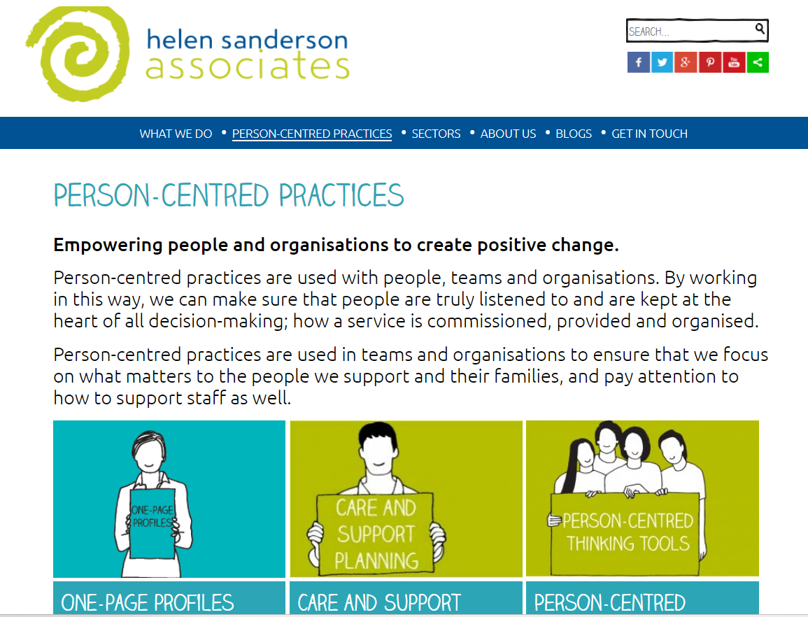
http://helensandersonassociates.co.uk/

Slide 10
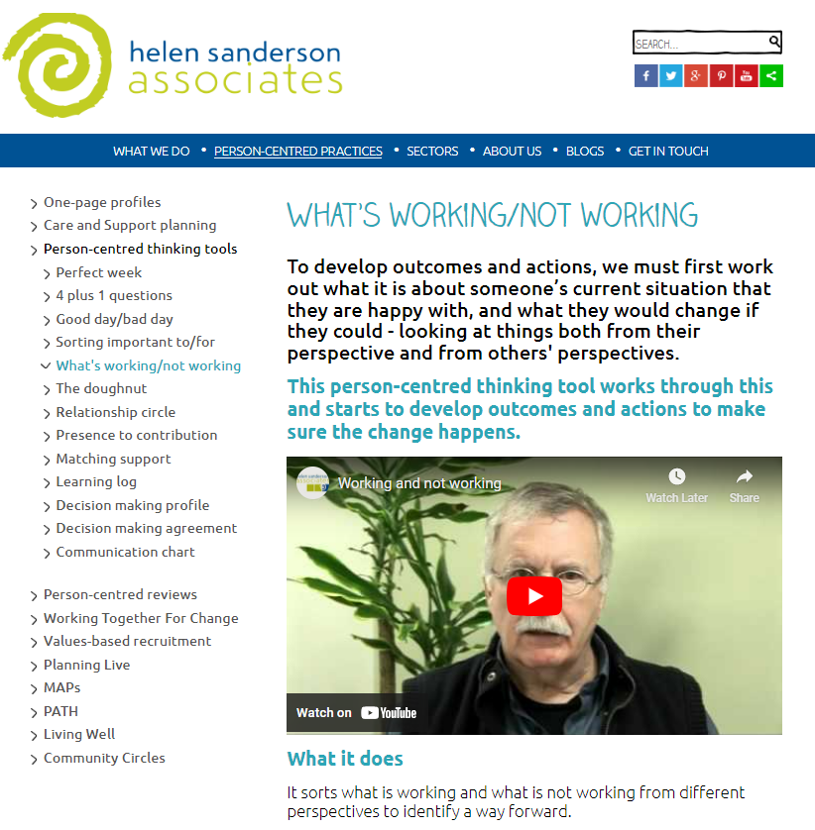
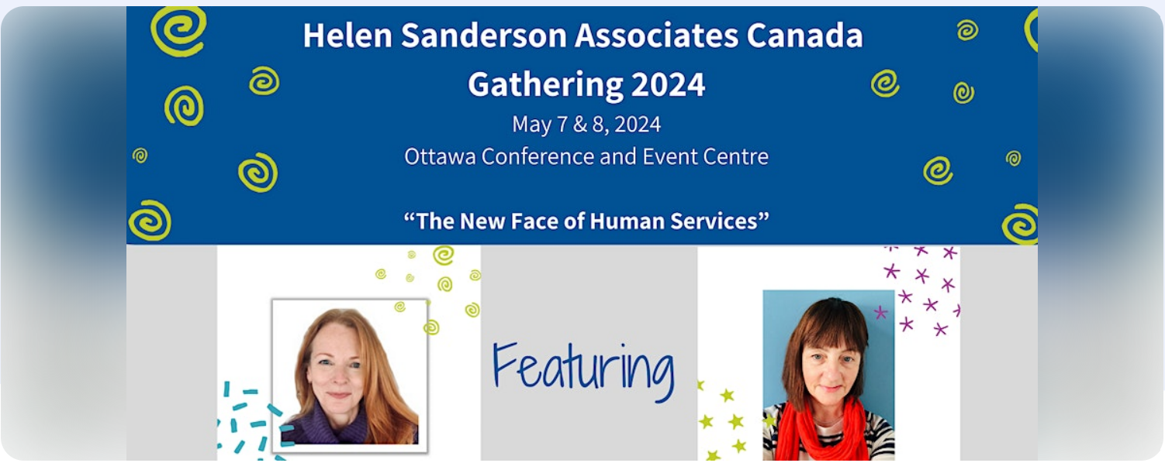
HSA
https://www.eventbrite.ca/e/hsa-canada-gathering-2024-registration-669504204097

Slide 11

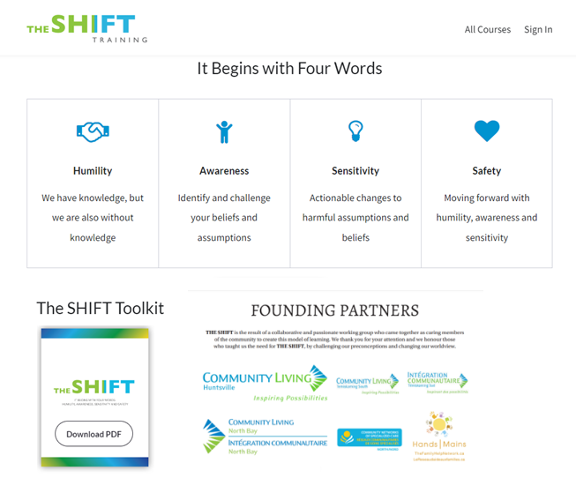
https://www.theshifttraining.ca/
Through funding provided by the Leveraging Community Planning Mechanisms to Support the Mental Health of Adults with Developmental Disabilities, Families and Caregivers During COVID-19 a group of likeminded people came together in North Eastern Ontario to try and find solutions to the complexity and lack of services for people in our community with intellectual disabilities whom are already significantly marginalized and at risk due to addictions, poverty, intergenerational trauma, gender and race.
THE SHIFT is a harm reduction focused resource for the developmental services sector. It is built around the person-centred, “Do Nothing about Us, Without Us” philosophy and is focused on non-judgement and inclusive care that is culturally sensitive, evidence-based, accessible and more than anything, individual-led and based on incremental gains.

Slide 12
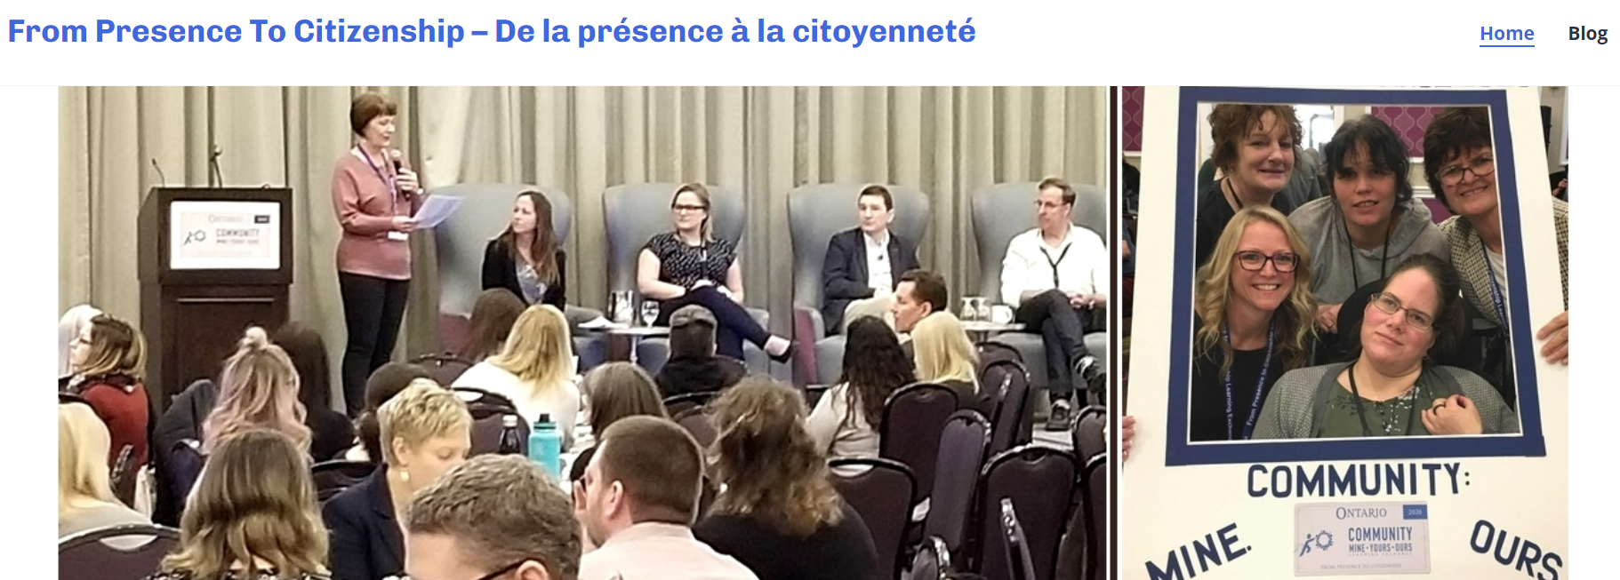

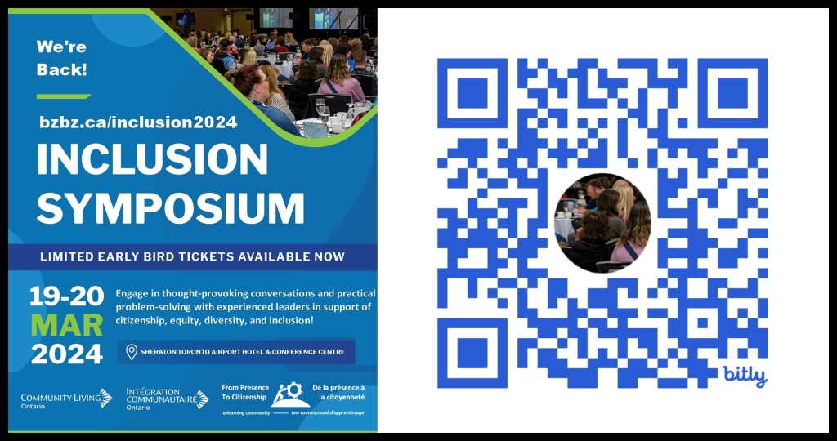
https://frompresencetocitizenship.wordpress.com/

Slide 13
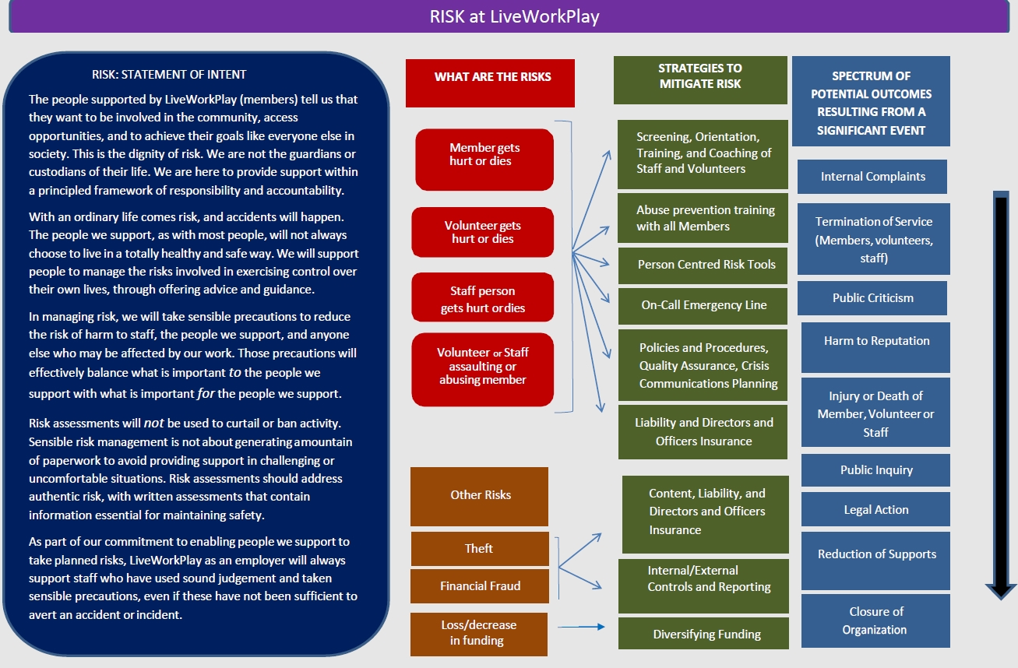
Risk at LiveWorkPlay

Slide 14
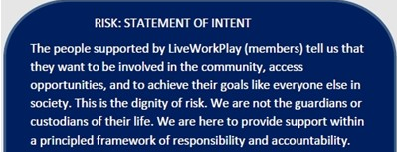
Risk 1

Slide 15
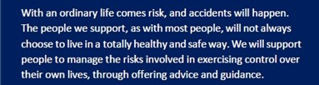
Ris2

Slide 16
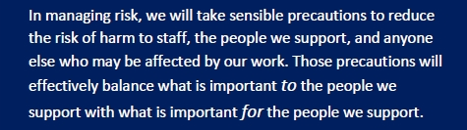
Ris3

Slide 17
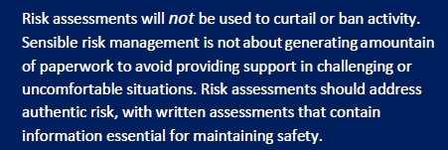
Ris4

Slide 18
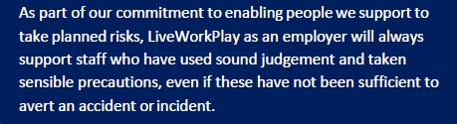
Ris5

Slide 19
Risk at LiveWorkPlay

Slide 20
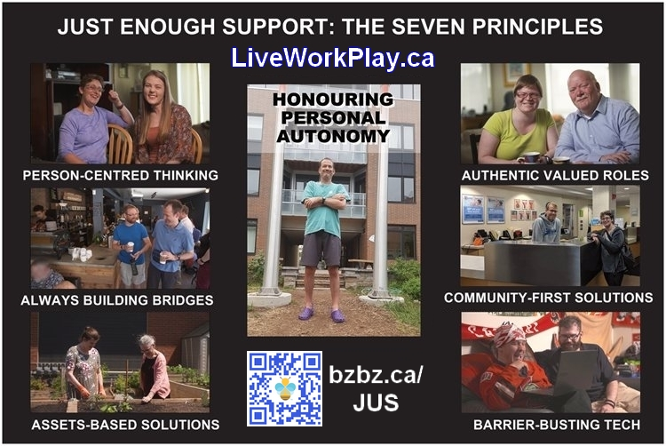
Just Enough Support

